Slide 1

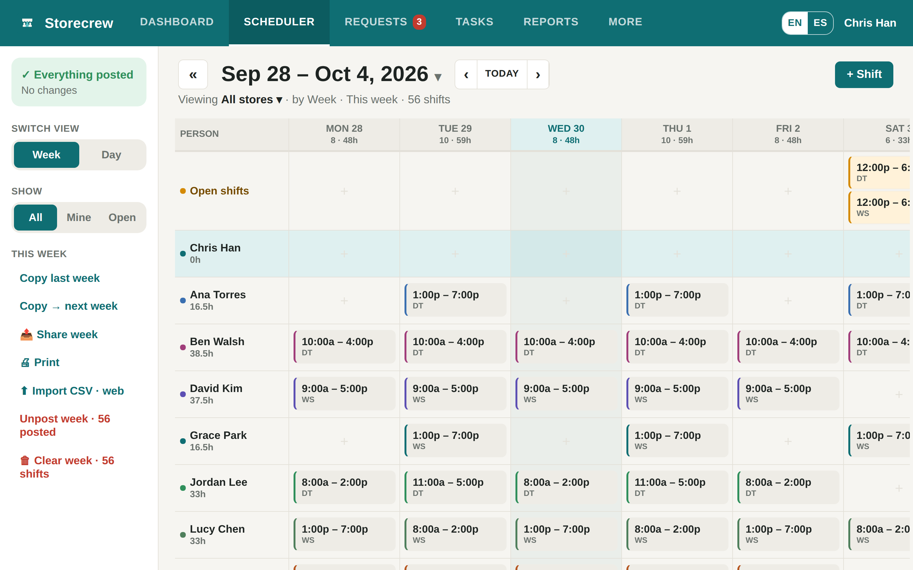
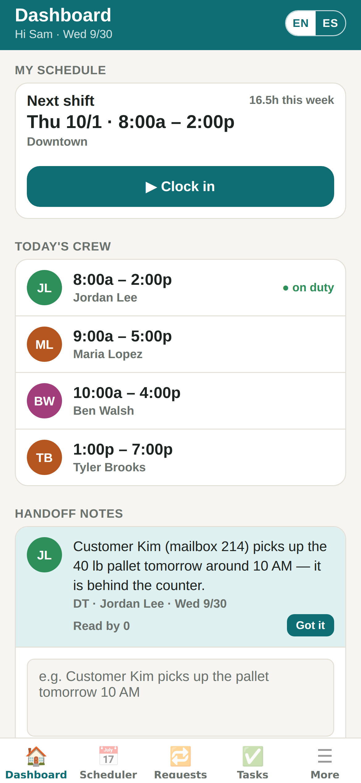
Storecrew
Schedules, time clock and checklists for your stores
One simple app for owners, managers and the crew — on the web and on Android.
storecrew.app

Slide 2




Running a store crew today
Storecrew
A schedule in a spreadsheet
Swaps by text message
Checklists on a clipboard
Punch cards into payroll
Printed, texted, changed, and printed again.
Who is actually working Saturday? Nobody is sure.
Opening and closing steps get skipped, and nobody knows.
Hours are typed in by hand, late and missed punches found too late.

Slide 3



One app for the whole shift
Storecrew
Schedule faster
Track time easier
Close the store right
The week on one grid. Drag to move, copy last week, post in one click.
Crew clock in and out on their phones; hours land on the timesheet.
Opening and closing checklists per store, with photos where it matters.

Slide 4



The Scheduler
Storecrew
The whole week for every store, on one screen
Click to add or change
An empty cell adds a shift; a shift opens its editor right under the row.
Drag, copy, repeat
Drag to move, hold Shift to copy, copy last week into this one.
Post the week
Drafts until you post; then everyone gets their days by email.

Slide 5
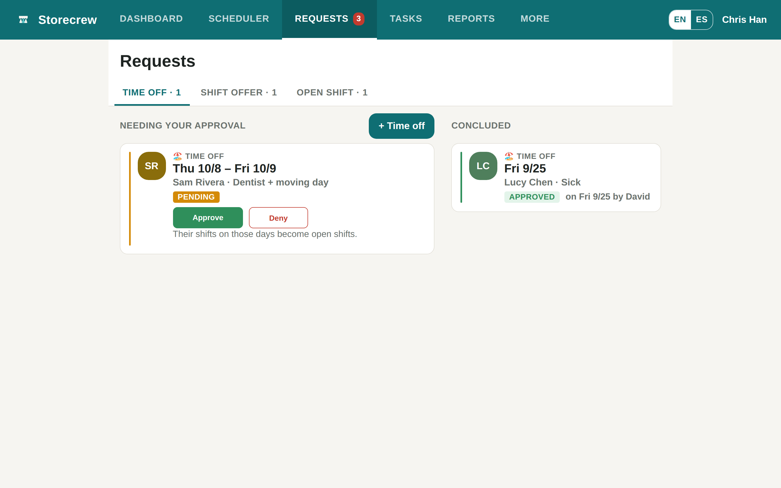
Requests, in one place
Storecrew
Time off, shift offers and open shift claims
Crew ask from their phones
Managers approve or deny with one click
The person is told right away
Approved time off opens the shifts on those days
Double bookings are refused

Slide 6
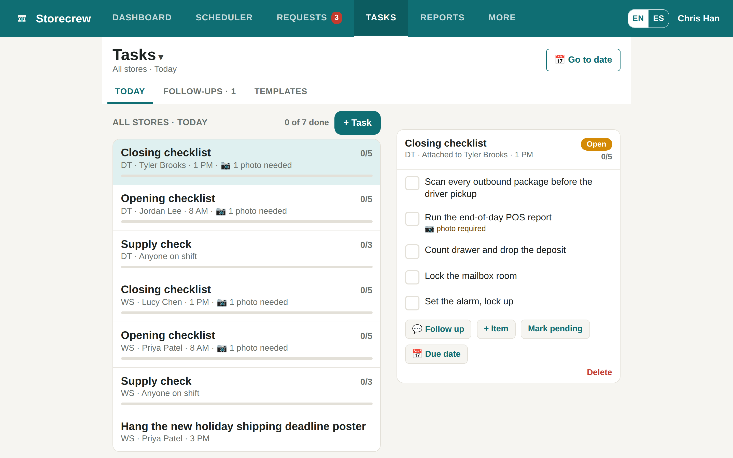


Tasks and checklists
Storecrew
Open and close the store the same way every day
Templates per store
Opening, closing, supply check — the lists come back every day.
Photo proof
An item can require a photo before it is ticked.
Follow-ups
Undone items carry over; one-off tasks get a due date.

Slide 7
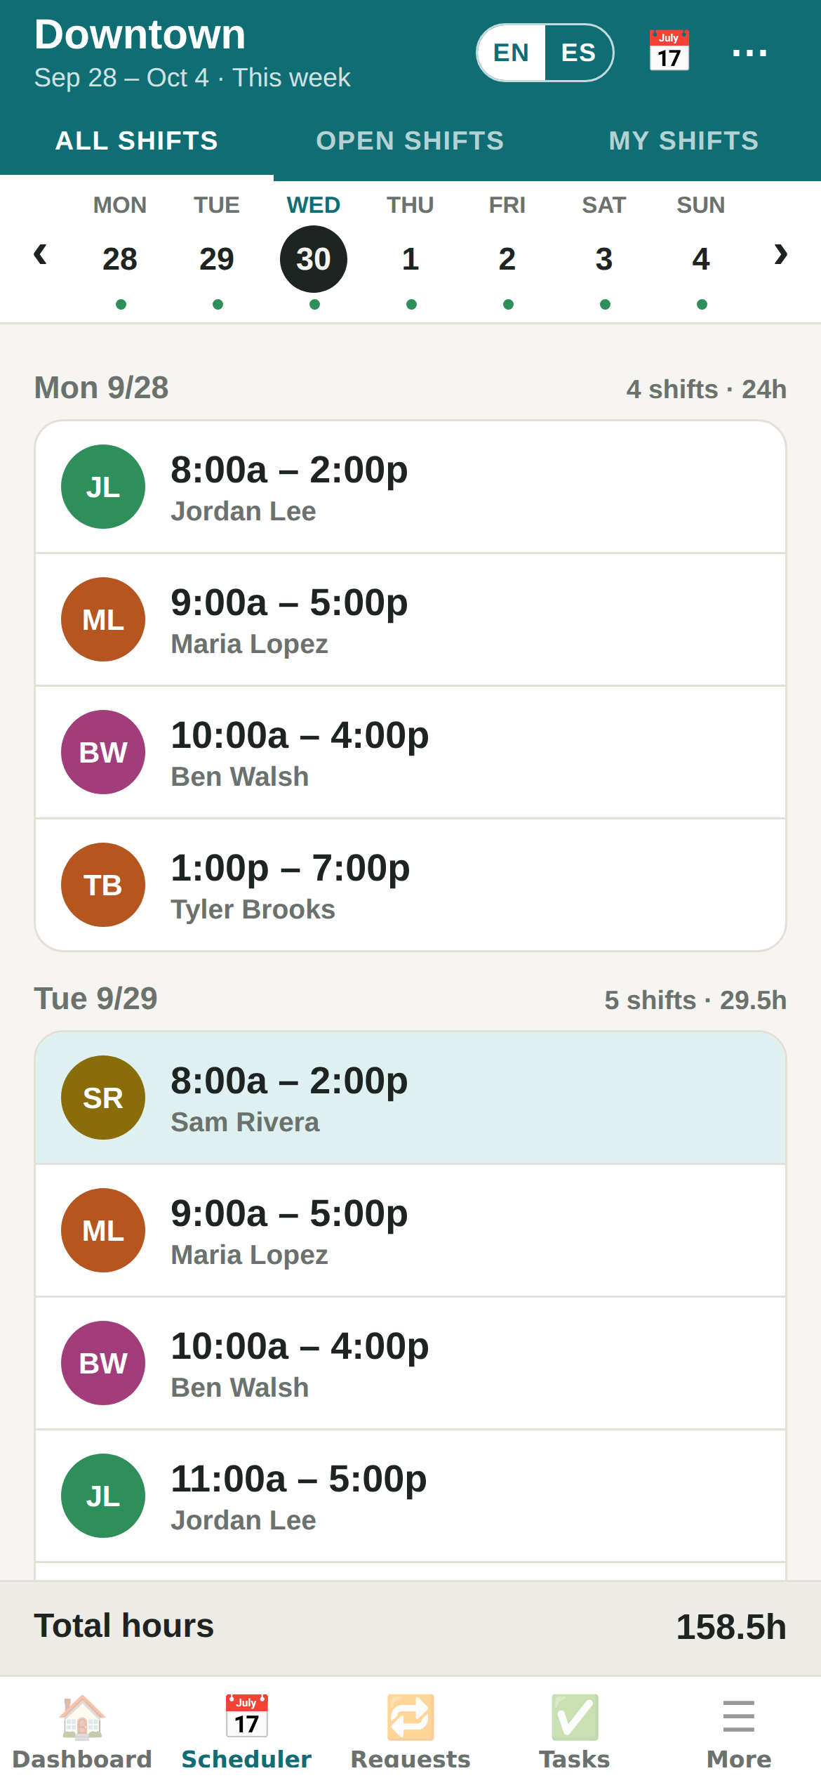
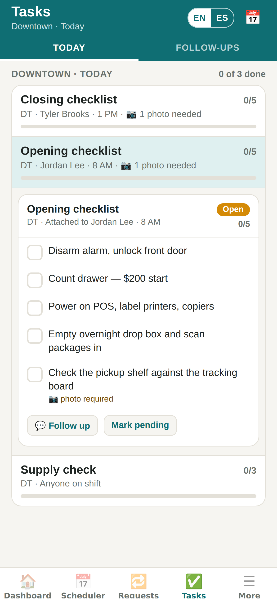
The crew’s phone
Storecrew
Everything an employee needs, and nothing more
Dashboard · clock in
My week · open shifts
Checklists

Slide 8
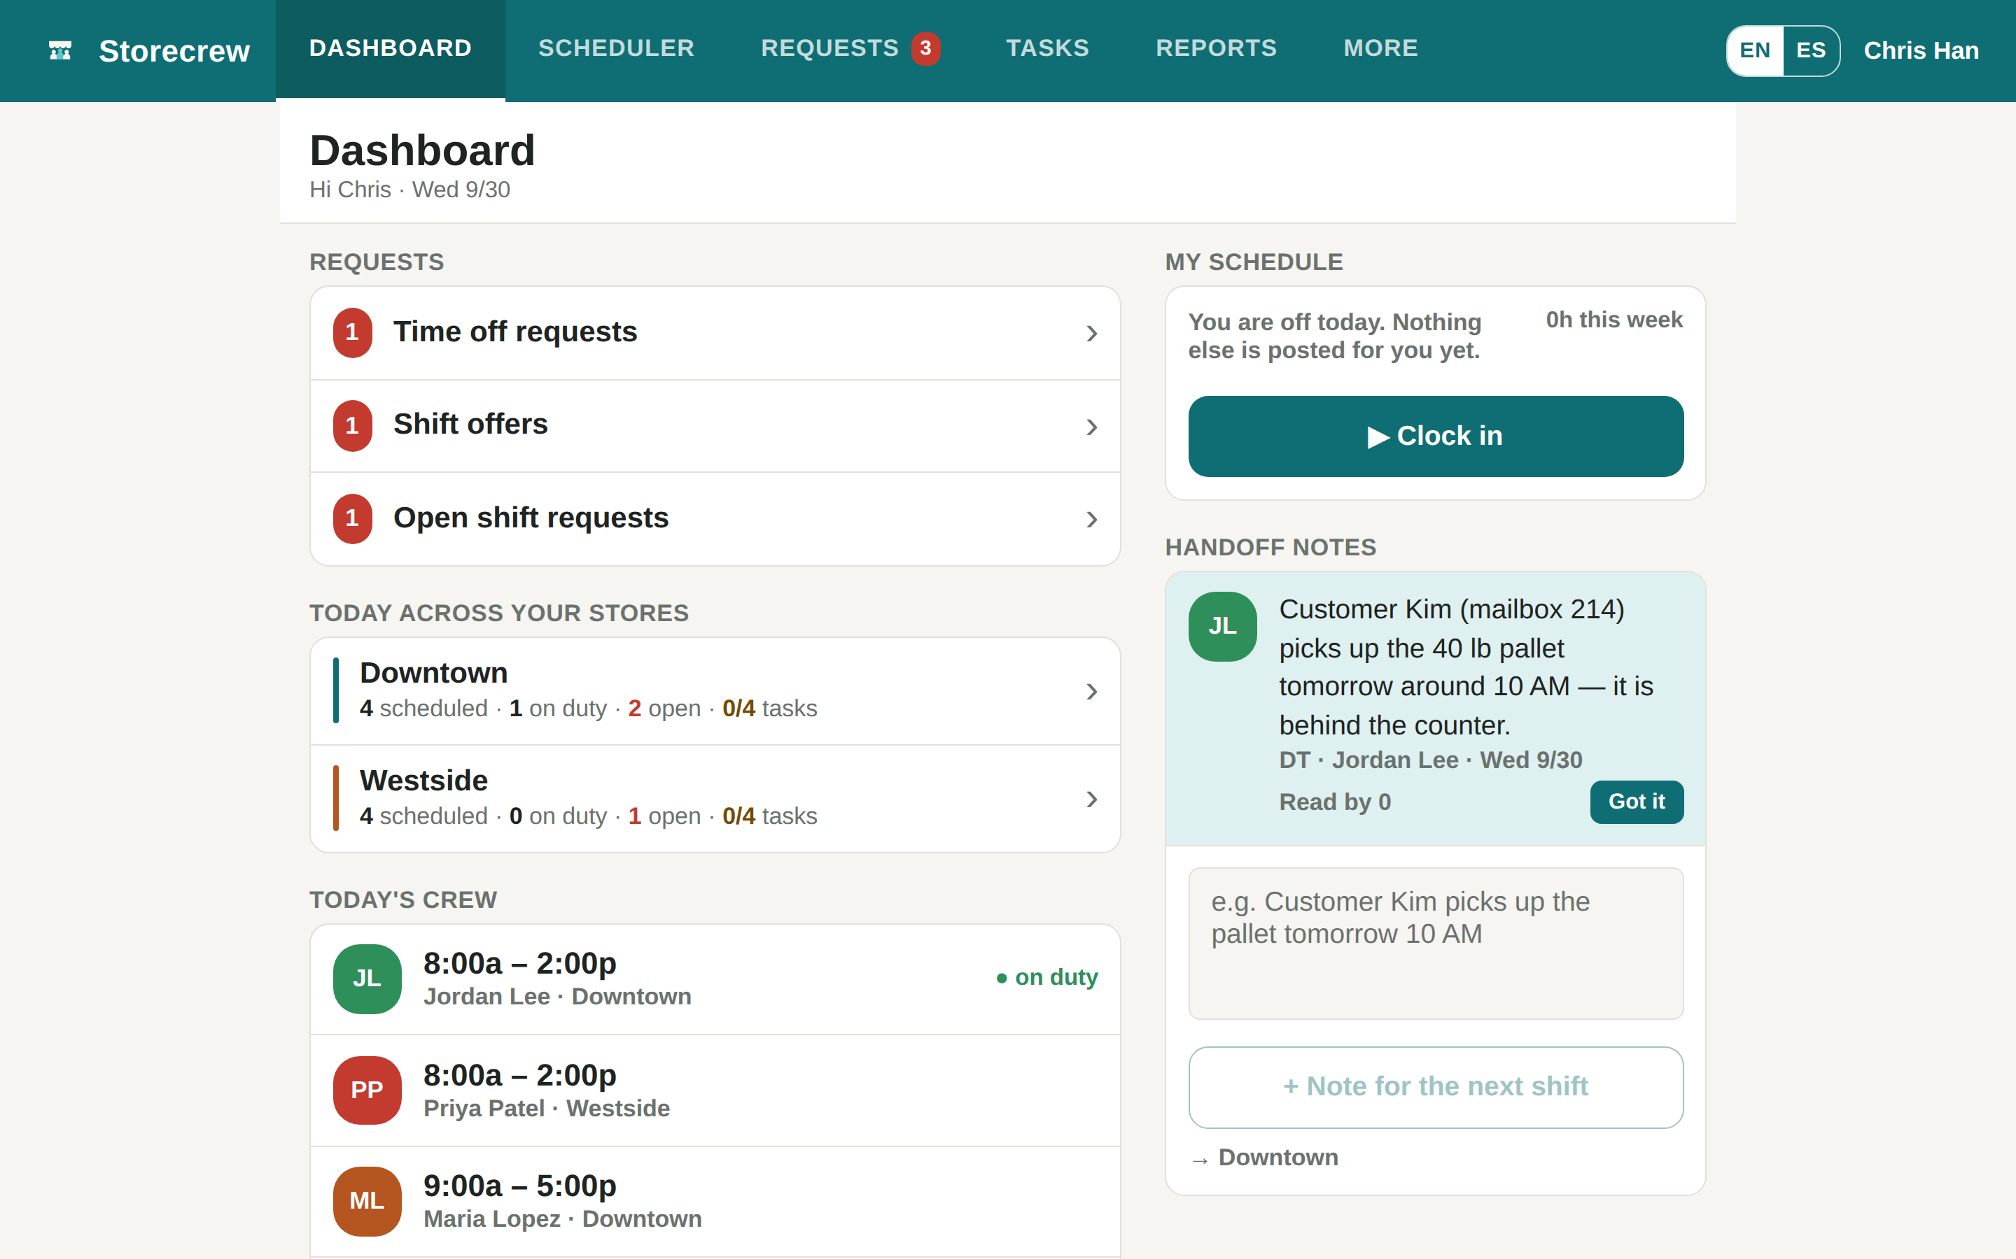



Who is on today?
Storecrew
The Dashboard for owners and managers
Every store at a glance
Scheduled, on duty, open shifts and tasks done, per store.
Requests waiting for you
Counted by kind, one tap to decide.
Handoff notes
What one shift leaves for the next, with who has read it.

Slide 9
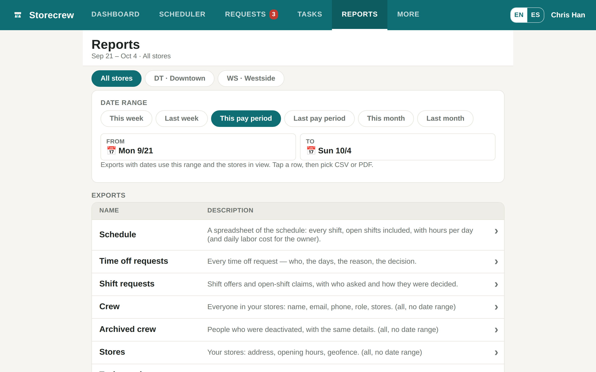

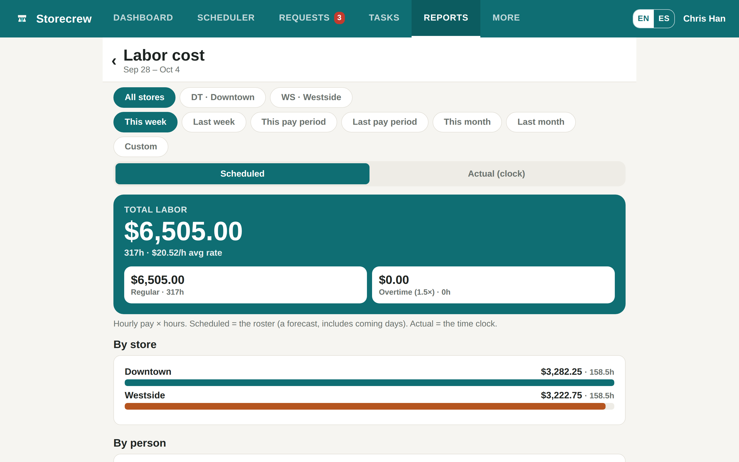


Reports and labor cost
Storecrew
For payroll, for the accountant, or to print
11 exports
Schedule, time off, timesheets, labor, attendance notices and more.
CSV or PDF
A spreadsheet for payroll, or a page to print.
Labor cost, owners only
Scheduled against actual, weekly overtime at 1.5×, behind a pay PIN.

Slide 10
The right screen for every role
Storecrew
Owner
General manager
Manager
Shift lead
Crew
Everything: stores, crew, pay rates, labor cost, reports.
The same access as the owner.
Builds and posts the schedule, decides requests for their stores.
Runs the checklists and verifies them.
Their schedule, the time clock, checklists and requests.

Slide 11
Ready in an afternoon
Storecrew
1
2
3
4
Sign up
Add your stores
Invite the crew
Post the first week
Create your business at storecrew.app.
Name, code, address and hours.
A code per store and role, or a login you make.
Build it on the grid, then post.

Slide 12

Pricing
Storecrew
Every feature, every store, every person
$0
Unlimited crew
Web and Android
Email notifications included
during the pilot
Cancel any time
When paid plans arrive they will be priced per store, not per person, with no long-term contract.

Slide 13
Try it today
Open the demo with two sample stores — no sign-up.
storecrew.app
Videos and this deck: storecrew.app/resources
Questions: support@storecrew.app

